Slide 1

EE-371 : Control Systems
Lecture#34
DESIGN VIA ROOT LOCUS
9.1 Introduction
9.2 Improving Steady-State Error
via Cascade Compensation
9.3 Improving Transient Reponse
via Cascade Compensation
Textbook: Chapter # 09 (5th edition)
Text Book: Control Systems Engineering by Norman S. Nise 5th Edition
Instructor: Ms Neelma Naz
Class: BEE 12 C/D
School of Electrical Engineering and Computer Science
Department of Electrical Engineering

Slide 2
Root Locus for Positive-Feedback
Systems

Slide 3
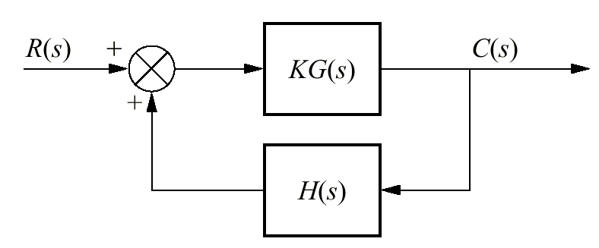
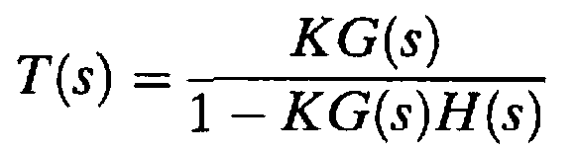


A positive-feedback system can be thought of as a negative-feedback system with a negative value of H(s)
The transfer function for the positive-feedback System is:

Slide 4
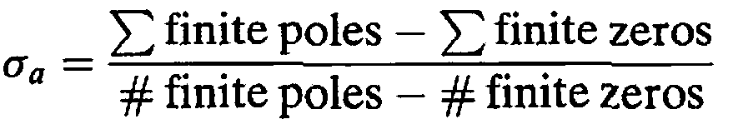
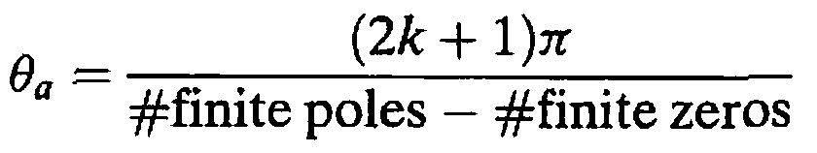
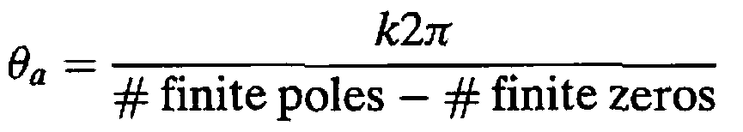
Real-axis segments:
On the real axis, the root locus for positive-feedback systems exists to the left of an even number of finite open-loop poles and/or finite open-loop zeros.
the real-axis intercept
For negative feedback system
Angle with the real axis

Slide 5
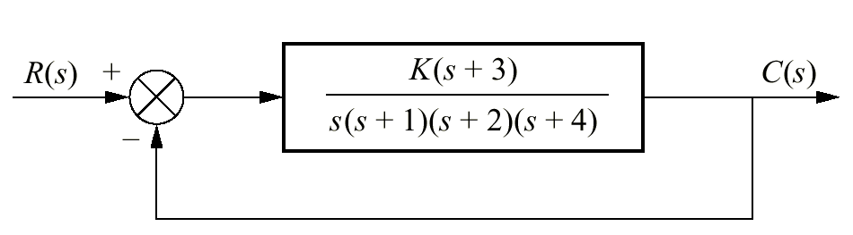
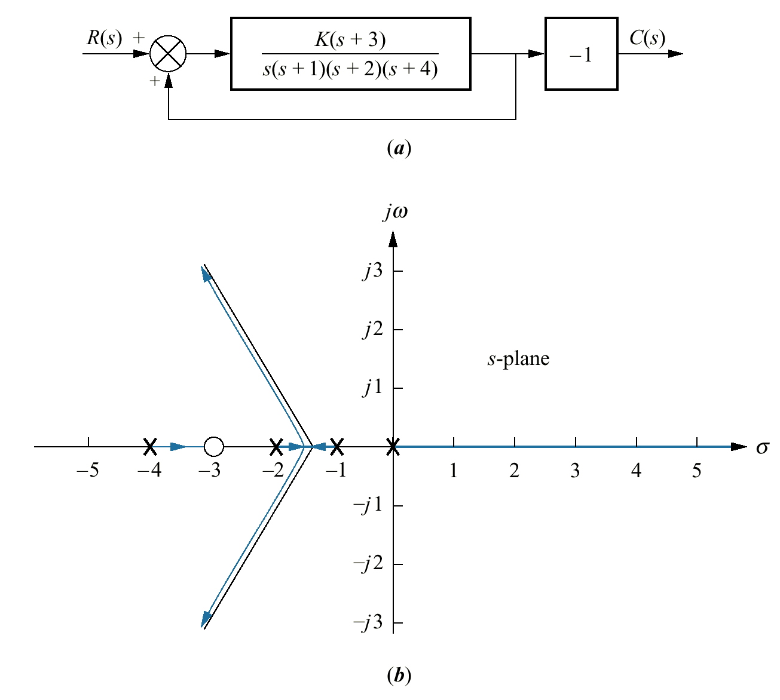
Example 8.9
Root Locus for a Positive-Feedback System
PROBLEM: Sketch the root locus as a function of negative gain, K, for the system shown in the Figure.
_
SOLUTION: The equivalent positive-feedback system found by pushing -1, associated with K, to the right past the pickoff point is:

Slide 6
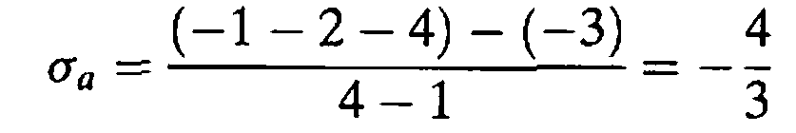
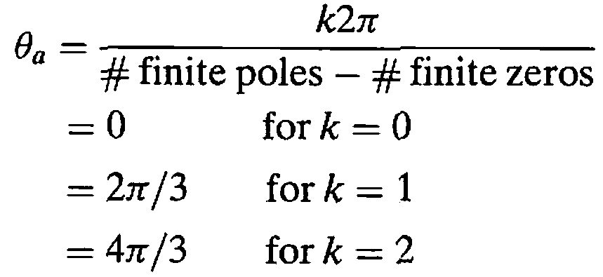

Slide 7
Pole Sensitivity

Slide 8
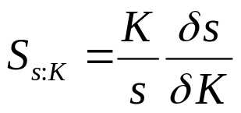
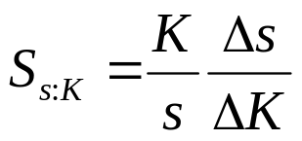
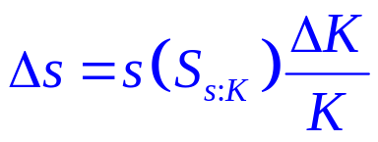
Definition
Root sensitivity is defined as the ratio of the fractional change in a closed-loop pole to the fractional change in a system parameter.
Converting the partials to finite increments, the actual change in the closed-loop poles is approximated as:
The sensitivity of a closed-loop pole, s, to gain, K is:
where s is the current pole location, and K is the current gain

Slide 9
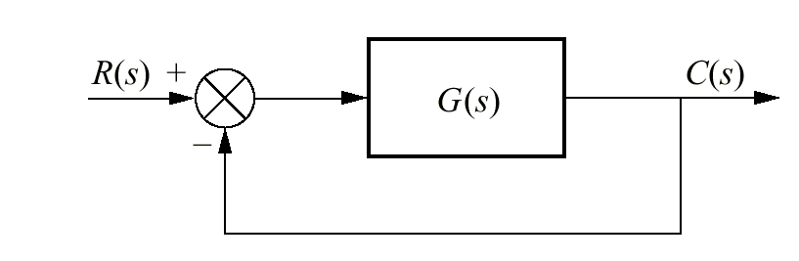
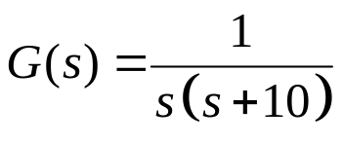
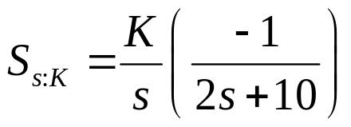
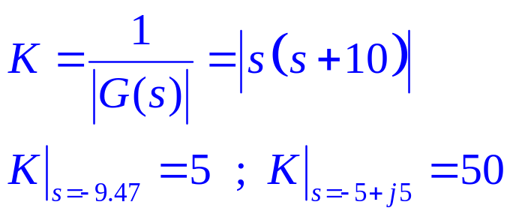
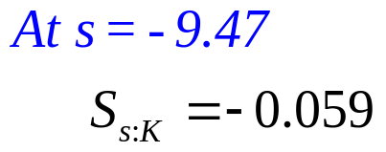
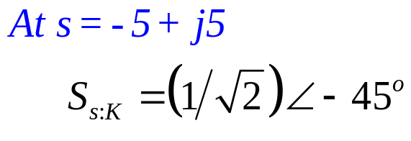
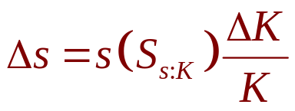
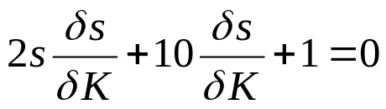
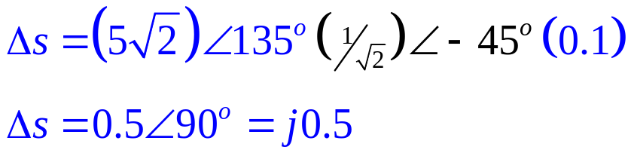
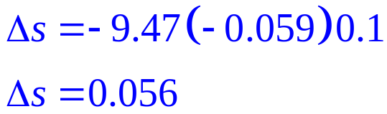
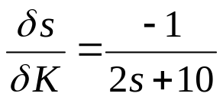
Root Sensitivity of a Closed-Loop System to Gain Variations
Example 8.10
PROBLEM: Find the root sensitivity of the system shown in the Figure at s = -9.47 and s = - 5 + j5. Also calculate the change in the pole location for a 10% change in K.
K
SOLUTION:
The characteristic equation is:
s² + 10s + K = 0
Differentiating with respect to K

Slide 10
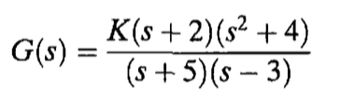
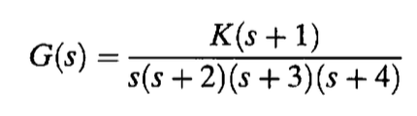
Examples

Slide 11
CHAPTER # 09
Design Via Root Locus
Improving Transient Response
Improving Steady-State Error
Improving Transient Response and Steady-State Error

Slide 12
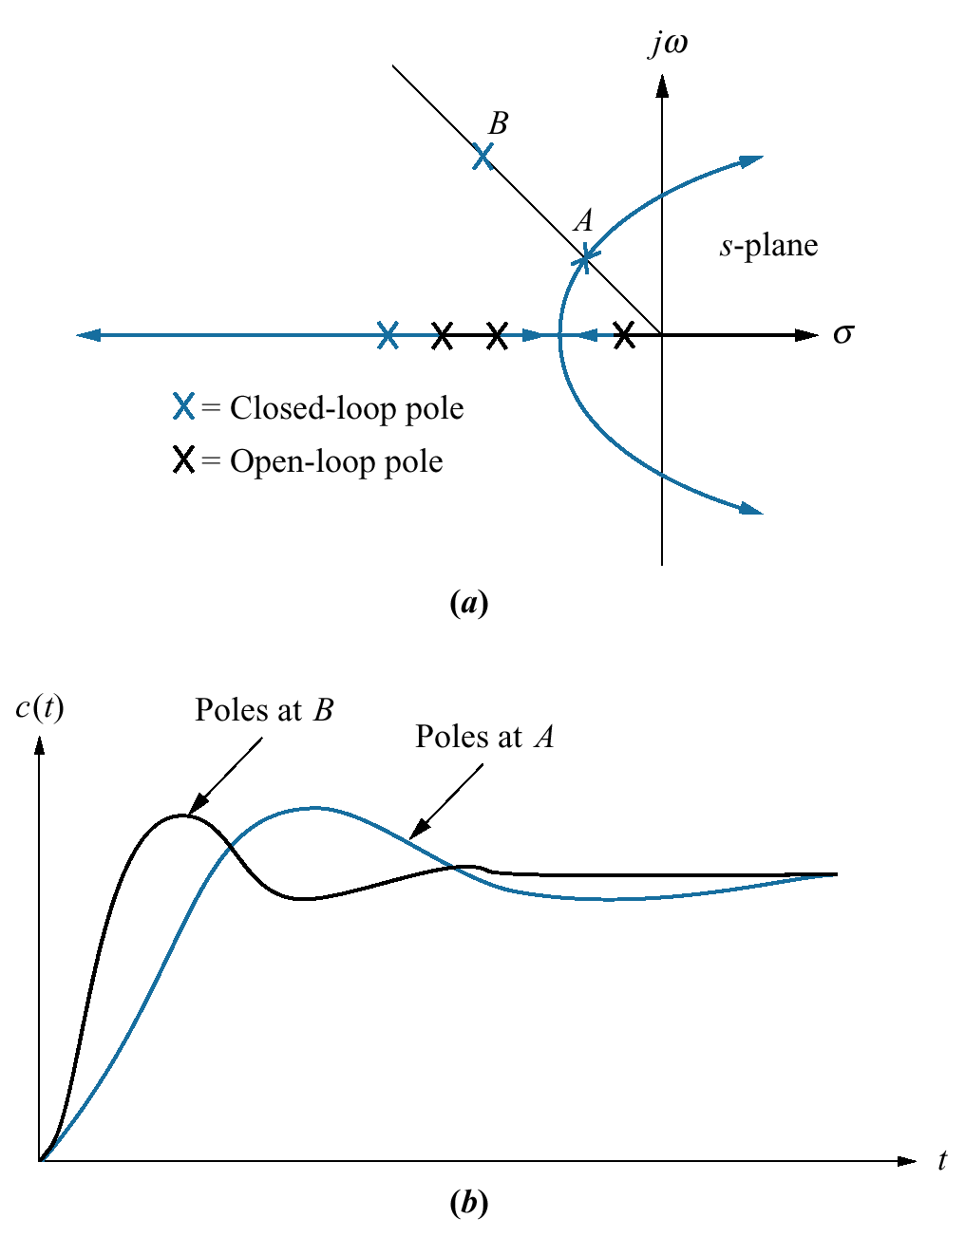
a. Root locus, showing
(i) Possible design point via gain adjustment (A)
Desired design point that cannot be met via simple gain adjustment (B)
b. Responses from poles at A and B
How can we move the pole to point B
???

Slide 13
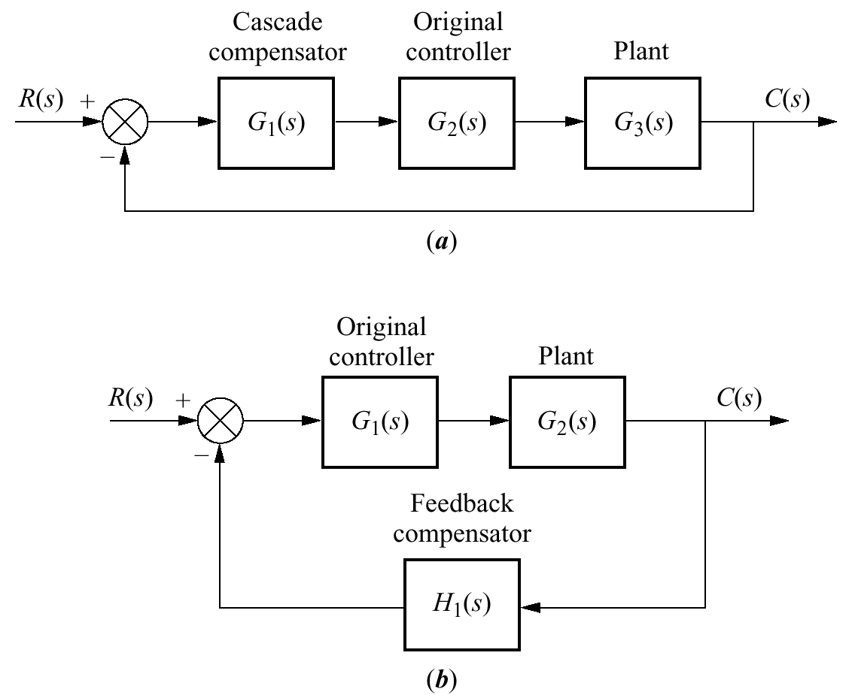
Configurations of Compensation
a. Cascade Compensation
b. Feedback Compensation

Slide 14
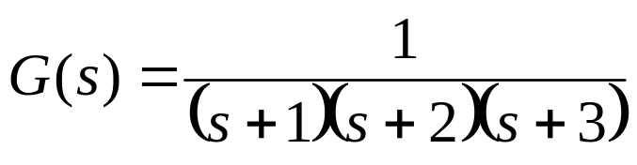
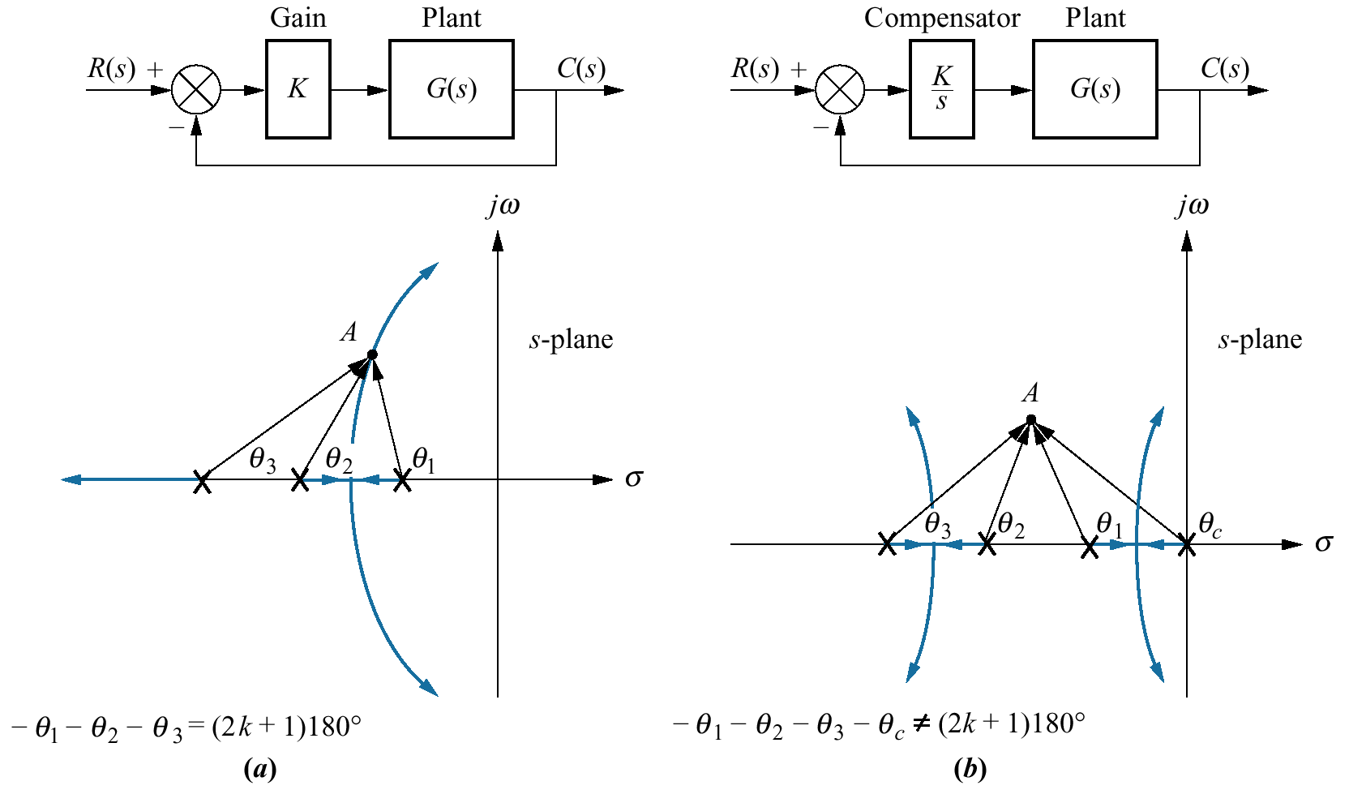
System Type ??
Steady state error ??
Transient response is satisfactory
We want to reduce the SS error without affecting the transient response
???

Slide 15
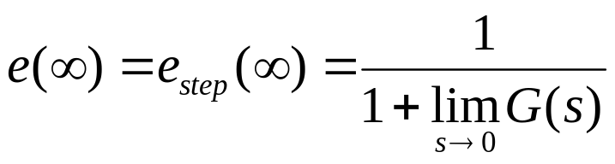
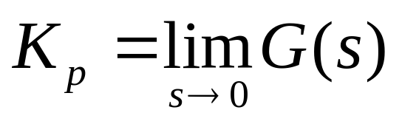
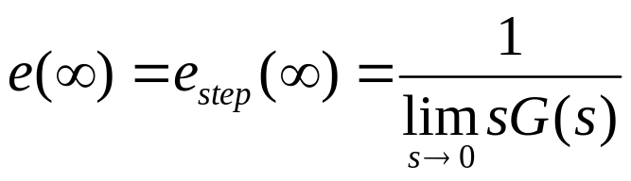
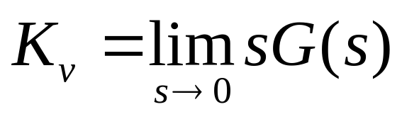
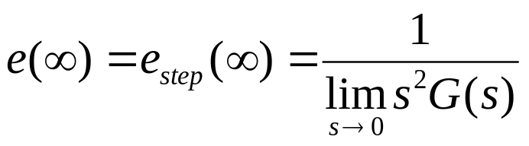
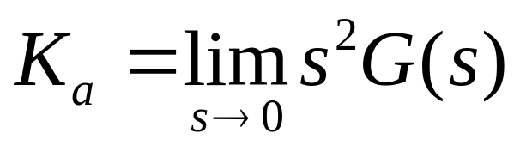
Static Error Constants
The three terms in the denominator that are taken to the limit determine the steady-state error.
These limits are the static error constants.
For a step input, u(t),
Position Constant, Kp
For a ramp input, tu(t),
Velocity Constant, Kv
For a parabolic input, ½ t²u(t).
Acceleration Constant, Ka

Slide 18
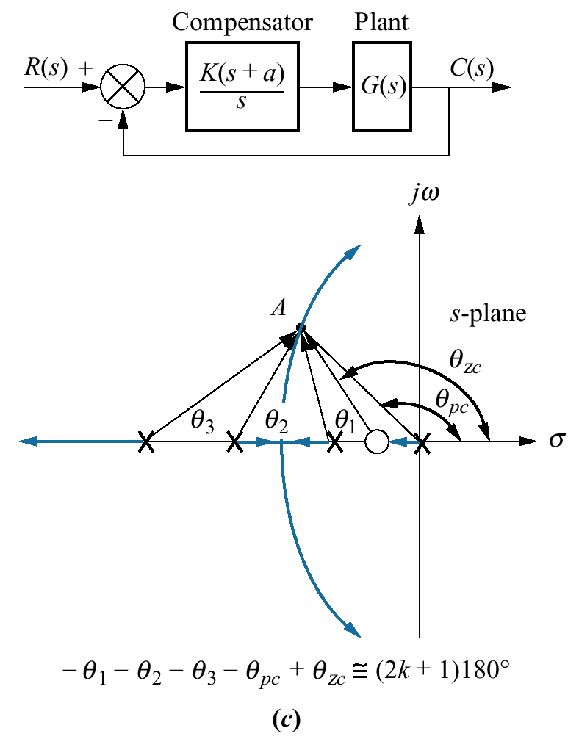
A compensator with a pole at the origin and a zero close to the pole is called
ideal integral compensator

Slide 19
Assignment
Work out and understand examples 9.1 and 9.2

Slide 20
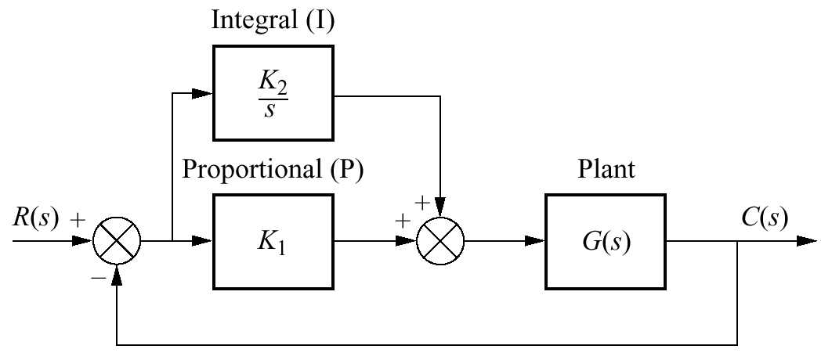
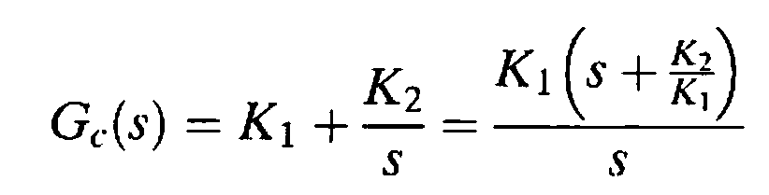
PI Controller
The error and the integral of the error are fed forward to the plant, G(s).
The system has both proportional and integral control
The alternate name, therefore, is PI controller
Ideal compensators are implemented with active networks
Require amplifiers and additional power sources

Slide 21
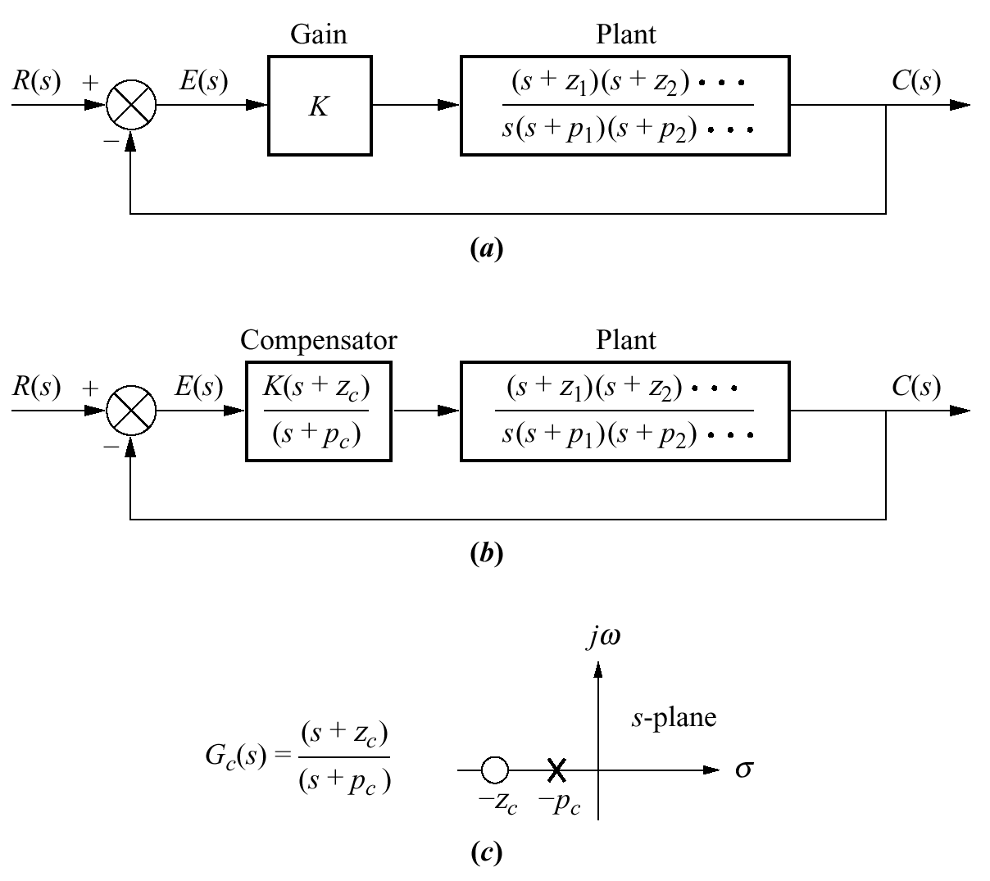
Lag Compensation
a. Type 1 uncompensated system
b. Type 1 compensated system
c. Compensator pole-zero plot

Slide 22
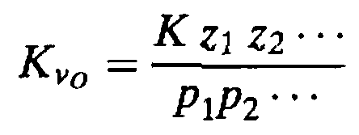
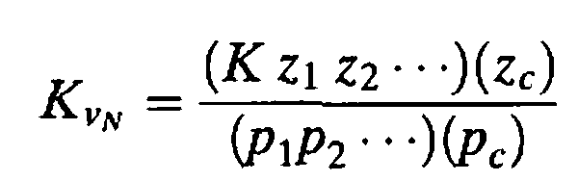
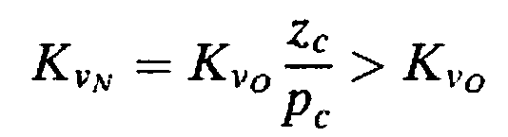
Lag Compensation
The static error constant for the uncompensated system is
The static error constant for the compensated system is

Slide 23
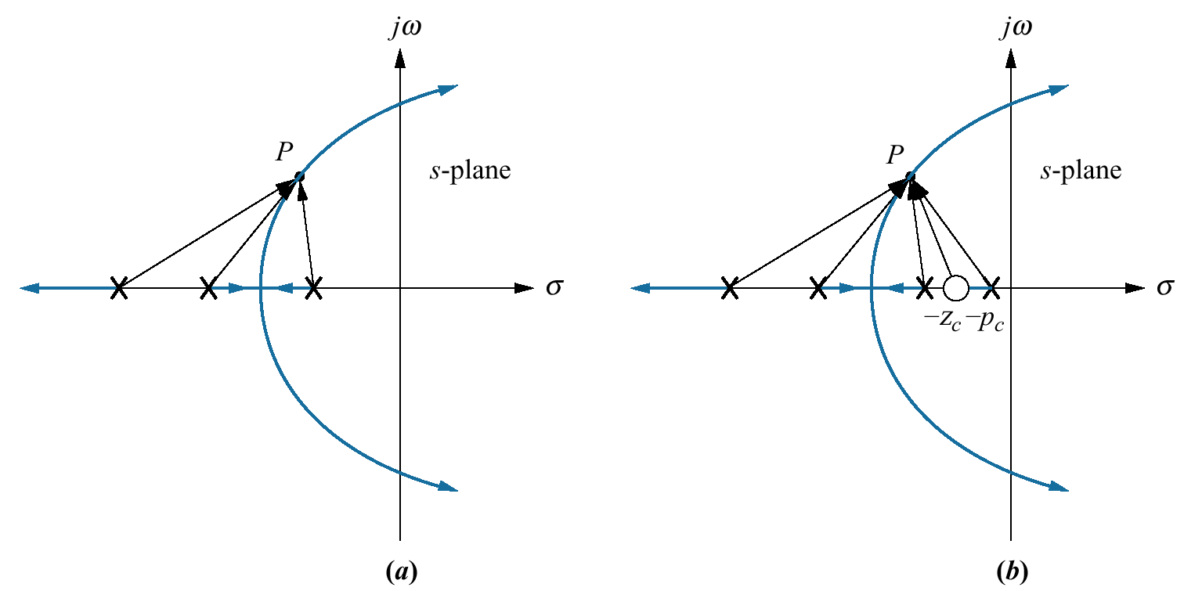
Root locus:
a. before lag compensation;
b. after lag compensation

Slide 24
Improving Transient Response
Typically, the objective is to design a response that has
desirable percent overshoot
and
shorter settling time
than the uncompensated system.
We will try to achieve the objective using
cascade compensation

Slide 25
Ideal Derivative Compensation (PD)
Lead Compensation

Slide 26
Ideal Derivative Compensation
A pure differentiator is added to the forward path of the feedback control system
requires an active network for its physical realization
The implementation consists of feeding the error (proportional) plus the derivative of the error forward to the plant
Thus the alternate name for an ideal derivative compensator is:
proportional-plus-derivative (PD) controller

Slide 27
Lead Compensator
When the cascade compensator does not employ pure differentiation it is called lead compensator

Slide 28
Ideal Derivative Compensation (PD)

Slide 29

Transient response of a system can be selected by choosing an appropriate closed-loop pole location on the s-plane
One way to speed up the original system is to add a single zero to the forward path
Transient responses unattainable by a simple gain adjustment can be obtained by augmenting the system's poles and zeros with an ideal derivative compensator

Slide 30
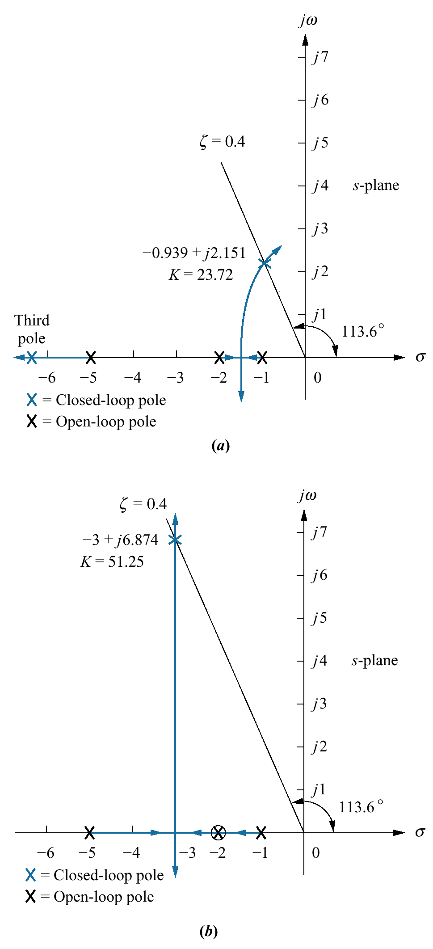
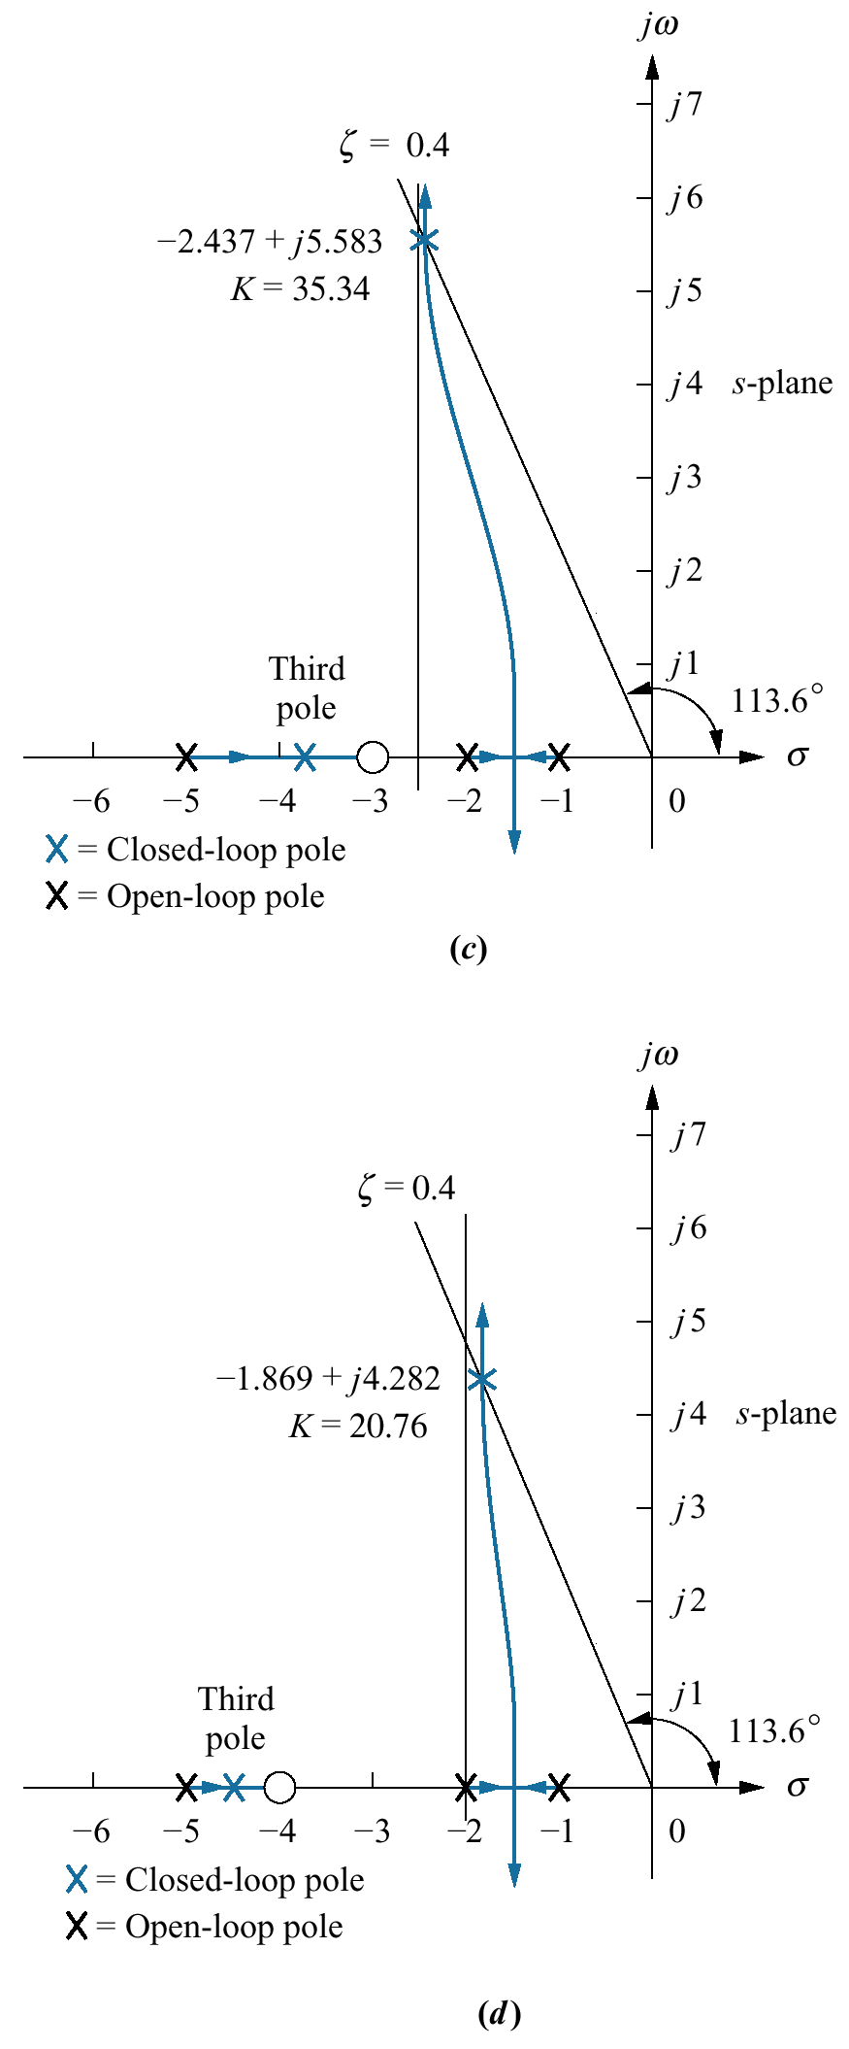
Examples
Uncompensated
Compensator zero at –2
Compensator zero at – 4
Compensator zero at –3

Slide 31
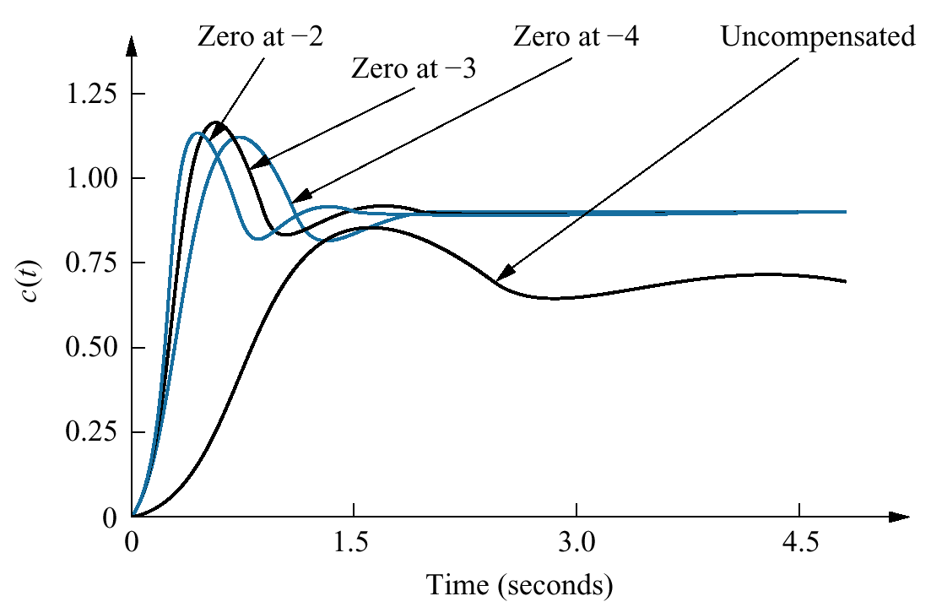
Step Response Comparison

Slide 32
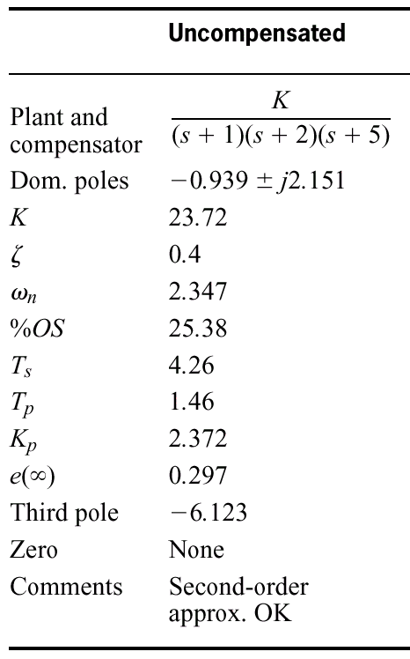
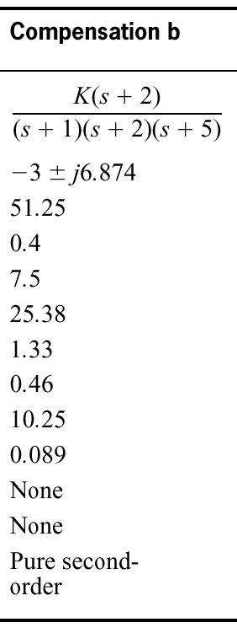
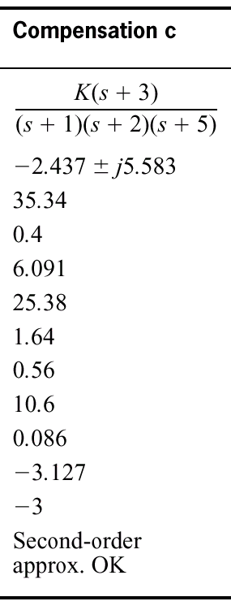
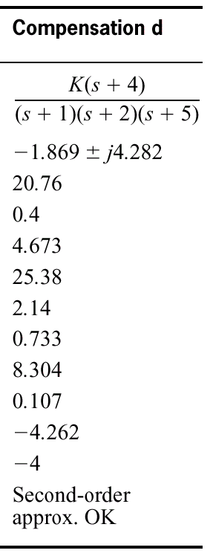
Comparison of
Compensated and Uncompensated systems

Slide 33

Example 9.3
Ideal Derivative Compensator Design
PROBLEM: Given the system shown in the Figure, design an ideal derivative compensator to yield a 16% overshoot, with a threefold reduction in settling time.

Slide 34


SOLUTION: Evaluate the performance of the uncompensated system operating with 16% overshoot.
The root locus for the uncompensated system is:
Since 16% overshoot is equivalent to ζ = 0.504
The dominant, second-order pair of poles is at -1.205 ±j2.064
Settling time of the uncompensated system is

Slide 35



Compensated dominant pole superimposed over the uncompensated root locus
To compensate the system, first we find the location of the compensated system's dominant poles.
To have a threefold reduction in the settling time, the compensated system's settling time will be 1.107.
Therefore, the real part of the compensated system's dominant, second-order pole is:
and

Slide 36



Evaluating the location of the compensating zero
The sum of the angles from the open loop poles to the desired dominant pole is
- 275.6
The angular contribution required from the compensator zero for the test point to be on the root locus is
- 180°-(-275.6°) = 95.6
From the geometry

Slide 37

Root locus for the
compensated system

Slide 38

Table 9.3
Uncompensated and compensated system characteristics for Example 9.3

Slide 39

Uncompensated and
compensated system step responses

Slide 40


Implementation of ideal derivative (PD) controller
K1/K2 is chosen to equal the negative of the compensator zero
K2 is chosen to contribute to the required loop-gain value

Slide 41

???

